Slide 1
bullying
Ms. Mary Grothem
Intervention Counselor,
Centennial High School
August 11, 2017

Slide 3
What Does Bullying Mean?
Bullying is deliberate and hurtful behavior meant to belittle, frighten, hurt, or exclude someone.
Bullying usually does not happen just once. It continues over and over.
Notes:
Remember it is how the OTHER person feels in the situation!

Slide 4
Conflicts vs Bullying
Conflict
A physical fight
An argument
One threatening text
One time occurrence
Bullying
Recurring physical violence
Repeated negative comments
Sending multiple threating texts
Repeated over time- Bullying is a pattern
Notes:
Perform skit #1
The key distinction to make here is made in the previous slide defining bullying. It’s something that happens repeatedly. While an “incident” should be reported to a staff member, it should not necessarily be labeled bullying, especially if you don’t even know the person who has committed the act.

Slide 5
Bullying is Violence
Violence Is Defined As:
Any unkind word, sign or act that hurts a person’s body, feelings or possessions.
Verbal
Visual
Social
Physical
Property
Cyber
Types of Bullying Violence:

Slide 6
VERBAL VIOLENCE
calling names,
threatening comments,
spreading rumors,
spreading gossip,
sexual harassment,
ridicule,
lying to get someone in trouble,
taunting and/or abusive language.

Slide 7
VISUAL VIOLENCE
drawing degrading pictures,
fake punches,
glaring,
smirking,
throwing shade
and stalking.

Slide 8
SOCIAL VIOLENCE
ignoring or excluding someone,
betraying trust,
encouraging others to dislike the person,
sabotaging a friendship.

Slide 9
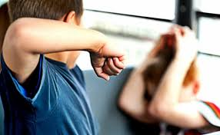
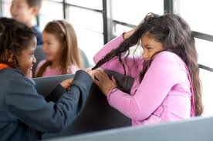
PHYSICAL VIOLENCE
hitting,
shoving,
kicking,
poking,
spitting,
grabbing,
blocking the path,
making threats.

Slide 10
PROPERTY VIOLENCE
dumping books,
breaking glasses,
ruining homework,
graffiti,
destruction of anyone’s personal property, including damage to school property.

Slide 11
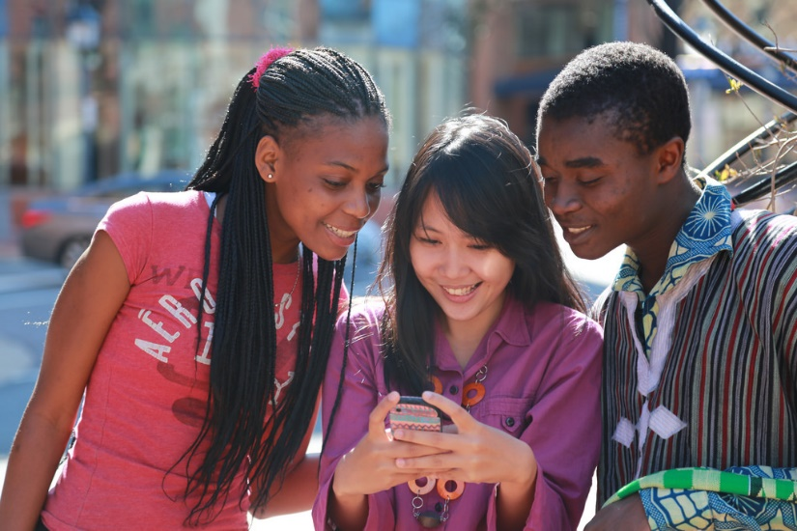
CYBER VIOLENCE
Occurs when a person torments, threatens, harasses, embarrasses and/or humiliates another person through the use of technology.
Texting
Snapchat
Twitter
Instagram
Facebook
E-Mail
Phone Calls
Any other tangible/virtual medium
Notes:
Inappropriate pictures of a sexual nature (of minors) through technological devices is illegal.
Misdemeanor- a criminal offense defined as less serious than a felony. Punishment: From 250 dollar fine up to 2500 dollars and up to 12 months in jail
Felony- an offense, as murder or burglary, of graver character than those called misdemeanors, especially those commonly punished in the U.S. by imprisonment for more than a year. Punishment: For certain types of felonies, the jury or court may choose imprisonment for one to 10 years or jail for up to 12 months and a fine of up to $2,500, either or both.
Video- Play “cyber+bullying” short video. It’s in the “Bullying Videos” folder on the flash drive.

Slide 12
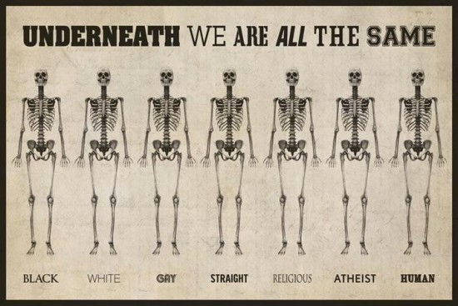
BULLYING AS A HATE CRIME
Bullying on the basis of
race,
ethnicity,
religion,
disability, or
sexual orientation
is a form of bias or hate.
These are all protected classes.
Bullying someone because the are a member of a protected class, can result in prosecution under the penalties of a hate crime.

Slide 13
RESPECT
Promote a culture of respect rather than a culture of hate and ignorance.

Slide 14
Board Policy 5208 on Bullying
No student or group of students shall,
through physical, written, verbal, or other means,
harass, sexually harass, threaten, intimidate, cyberbully, cause bodily injury to,
or commit hate violence against
any other student or school personnel.
Notes:
Focus on the highlighted terms rather than reading the entire page.

Slide 15
Board Policy on Cyberbullying
Cyberbullying includes
the transmission of harassing communications,
direct threats,
or other harmful texts, sounds, or images
on
the internet,
social media,
or other technologies using
a telephone,
computer,
or any wireless communication device.
Cyberbullying also includes
breaking into another person’s electronic account and assuming that person’s identity in order to damage that person’s reputation.

Slide 16
Board Policy on Bullying
Students who engage in bullying (including cyberbullying)
on campus,
traveling to or from school,
at school activities,
or in a manner otherwise related to school attendance,
shall be subject to School/District disciplinary procedures.

Slide 17
Statistics
Between 20% and 56% of young people are involved in bullying annually as either a Victim, Perpetrator, or By-stander
In a class of 42 between 8 and 24 are involved in bullying.
In this room that means between 55 and 154 students are involved in bullying.

Slide 18
SEXUAL HARASSMENT
Any unwelcome behavior of a sexual nature that:
offends,
humiliates,
or intimidates
another individual.
Sexual comments about the body
Sexual gestures
Sexual touching
Sexual drawings
Sexual advances, propositions, or suggestions
Spreading rumors about other students' sexual activity
Sexual "dirty" jokes
Showing offensive/sexual pictures, stories, or objects
Sexting
Notes:
Remember that it is how the other person FEELS about the comments or situation it is not how you may mean it…. Also remember that overheard comments or jokes can be offensive to some…. So please be cautious!
Go to youtube and play the following youtube clips: http://www.youtube.com/watch?v=030AewwQaTk
& http://www.youtube.com/watch?feature=endscreen&NR=1&v=Bv6krkEG7ao

Slide 19
Sexual Harassment
Taking selfies of a sexual nature and sending them to another person.
Sending sexually suggestive pictures or videos of anyone under the age of 18 on any social media format is considered distribution of child pornography. Even possessing the images on your phone is illegal.
Distribution and possession of child pornography are criminal offenses. If convicted, the perpetrator can receive probation or prison time, can be sued civilly, and can be mandated to register as a sex offender for the rest of his or her life.
If registered as a sex offender or convicted of a felony, you may be prohibited from careers in law enforcement, teaching, and professions dealing with children. This includes volunteer work in these areas.

Slide 20
If you are Sexually Harassed:
Tell the perpetrator to stop!
Tell your parent or trusted adult.
Tell an administrator, counselor, or other trusted adult on campus.
Tell the School Resource Officer – Officer Clary.
Complete a formal sexual harassment complaint form. This will initiate a formal investigation designed to stop the harassment immediately and to hold the perpetrator accountable for his/her actions.

Slide 21
IF YOU’RE BULLIED
DO
DON’T
Avoid the bully.
Be confident. Use a firm voice to tell the bully to “STOP”.
Remain calm. Self-control gives you power.
Tell a trusted adult.
Hang with friends who will stand by you.
Believe in yourself.
Keep an accurate record of dates, times, and location(s) where you have been bullied.
Go to places you know he/she will be
Act intimidated or scared.
Be aggressive. Fighting will get you into trouble.
Go to places where no adults are present.
Keep this a secret
Believe the bully
Think you’ll remember all the details.

Slide 22
IF YOU SEE BULLYING
DO
DON’T
Speak Up
Calm the situation
Tell an adult what’s happening
Offer your support to the bullied person
Stand By
Join in or encourage the bully
Spread the story of the bullying episode as gossip
Engage the bully
Notes:
Perform skit #2

Slide 23
PEOPLE ON CAMPUS WHO CAN HELP
Teachers
Aides
Secretaries
Custodians
Security Guards
Coaches
Administrators
Librarian
School Resource Officer (SRO): Officer Clary
Your Counselor:
A-Cas Mrs. Grover
Cat-Gao Mr. Godinez
Gap-Key Mrs. Finney
Kez-Moq Ms. Jaime
Mor-Rea Ms. Creeden
Reb-Too Mrs. Thompson
Top-Z & Puente Mr. Gomez
Intervention Ms. Grothem

